Slide 1
Matthias Obst & Tobias Andermann
Gothenburg Global Biodiversity Center
http://ggbc.gu.se/

Slide 2
Swedish Biodiversity Data Infrastructure
Support Center
APIs

Slide 3
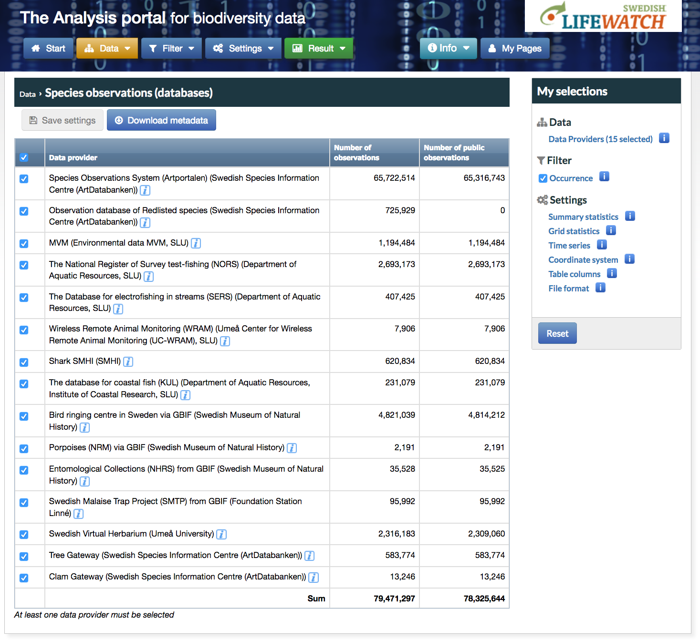
App 80 million measurements & observations from Sweden
(excl. sequence data)

Slide 4
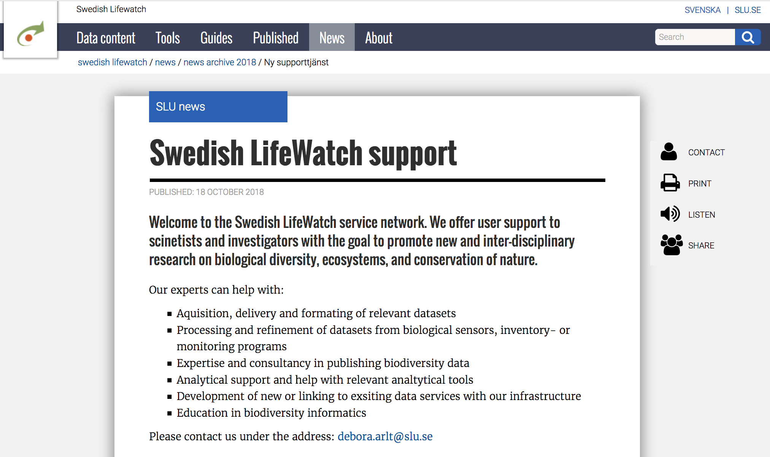

Slide 5
Python for biologists Program
12.00 – 13.00 | Installation
13.00 - 13.15 | Intro to python
13.15 - 14.30 | Tutorial 1 (A)
14.30 - 15.00 | Recap & feedback
15.00 - 15.15 | Short coffee break
15.15 - 16.30 | Tutorial 2 (A and B)
16.30 - 17.00 | Recap & feedback

